Slide 1
Week 4 – lesson 1

Slide 2
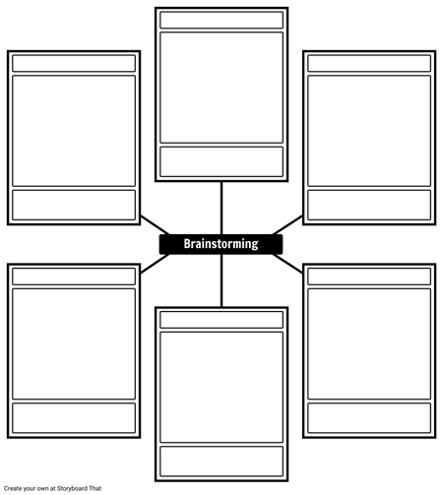
EQ: what are the different types of graphs?
TOPIC: Graphs
Picture graph
Column graph
Clustered column graph
Line graph
Conversion
Step graph
Pie graph

Slide 3
Week 4 – lesson 2

Slide 4
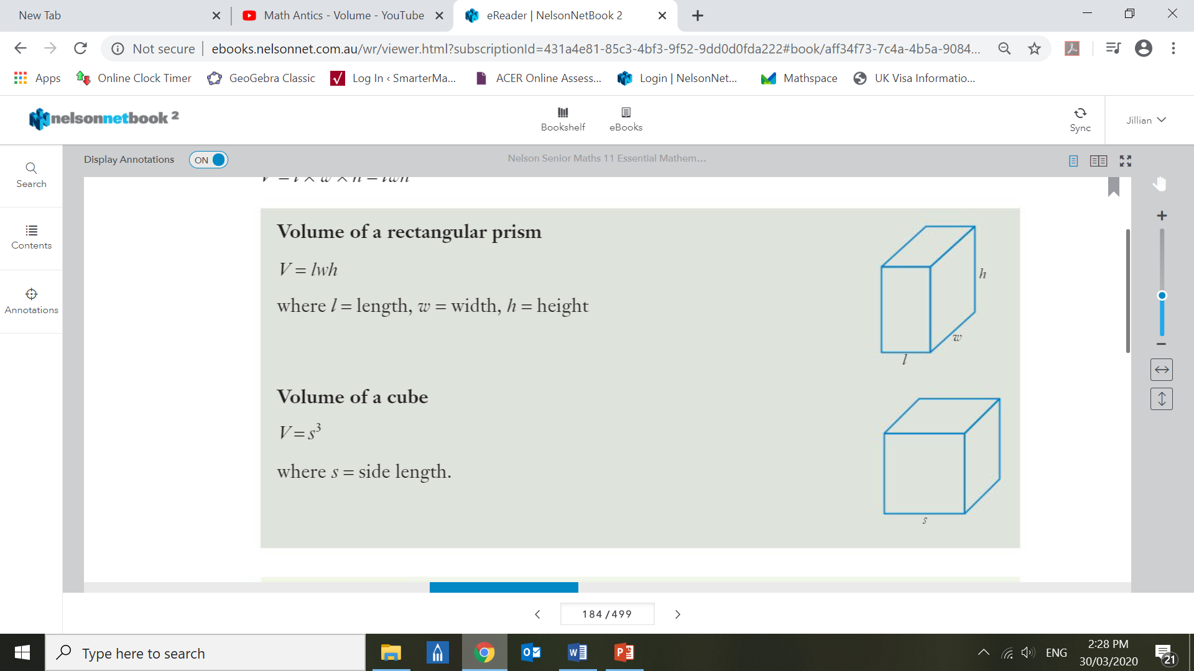
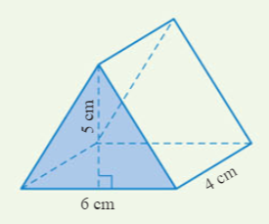
EQ: how do we calculate the volume of rectangular prisms?
TOPIC: measurement
What is a prism?
A prism is a solid object with:
identical ends
All faces are flat (no curves)
- the same cross section all along its length
Rectangular Prims Formula
Cube
Formula
Triangular prism
Formula
Volume = $lwh$
Volume = $s^{3}$
Volume = $\frac{1}{2} bh$

Slide 5
Week 4 – lesson 3

Slide 6
Week 4 – lesson 4

Slide 7
EQ: How do we represent information in a 2-way table?
TOPIC: Graphs
Two-way tables organise data based on two categorical variables.
 | Science | Humanities | Arts | TOTAL
Women | 24 |  | 25 | 74
Men
TOTAL | 46 | 60 |  | 162
What percentage of people are men?
What percentage are women that like humanities?
What percentage like science?

